Slide 1
Spectral Clustering
Kaicheng Guo & Zhengyu Zou
Notes:
Introduction. The framework of

Slide 2
Contents
Definition of clustering in graph theory
Mathematical tools to define good clusters
This presentation: focus on 2-clusters
Propose a time-efficient algorithm to find good 2-cluster

Slide 3
What is a Cluster?
What is a Cluster (in Graph Theory)?

Slide 4
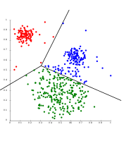

Clusters (Data Science)
A group of data points that “gathers around” a particular value
Distance between two data points from the same cluster is small
Distance between two data points from different clusters is big
High inter-cluster distance
Low intra-cluster distance

Slide 5
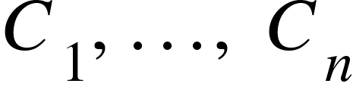
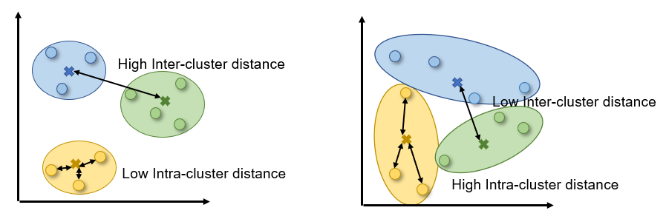
Clusters (Graph Theory Analogue)
A set of clusters { } of a graph G=(V, E) is a partition of V that satisfies the following properties:
Small intra-cluster distance
Big inter-cluster distance

Slide 6
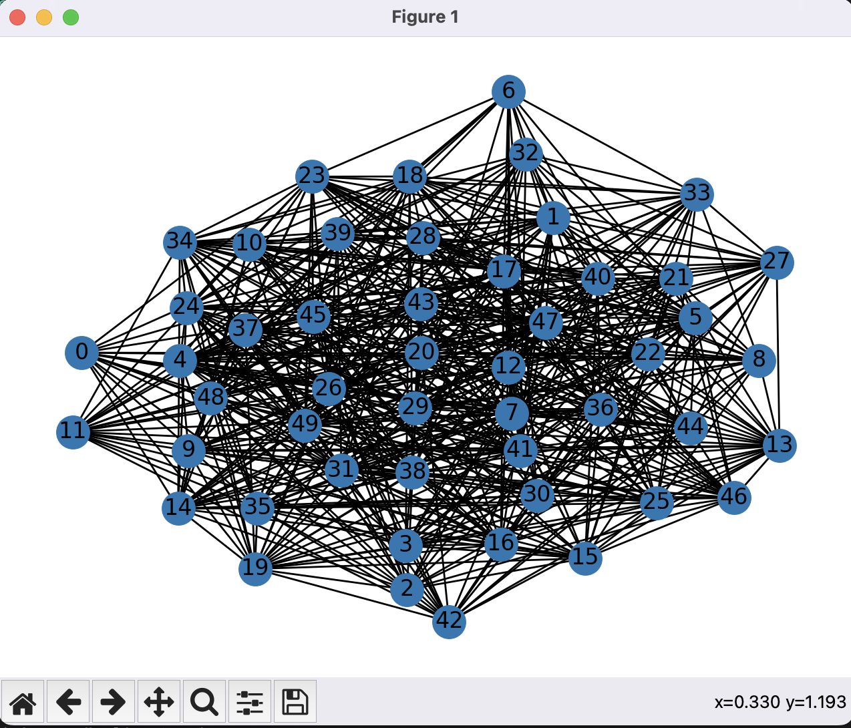
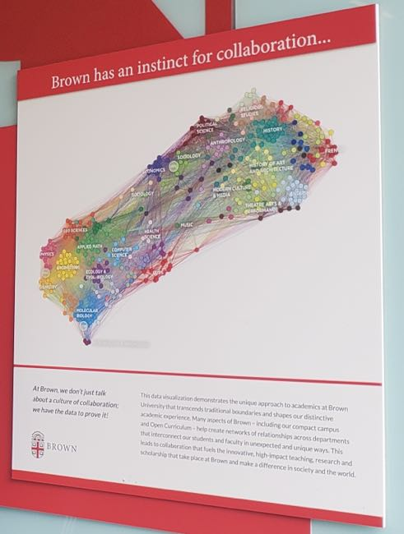
Q: How to Find “Good” Clusters in an Extremely Large and Messy Graph ?

Slide 7
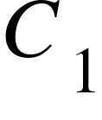
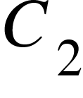
What Partitions Give “Good” Clusters?
This presentation, focuses on 2-clusters of V (partition the vertices into two subsets and )

Slide 8
Examples of 2-Clusters
Need to remove too many edges

Slide 9
Examples of 2-Clusters
Two subgraphs are not “balanced in size”

Slide 10
What Partitions Give “Good” Clusters?
Key Observations:
Only need to delete a small number of edges between the two clusters
Two clusters are “balanced in size”
They have similar number of vertices / edges

Slide 11
Mathematical Tools to Define “Good” Clusters

Slide 12
Volume of a Subgraph
Definition: Volume = sum of the degrees of all vertices in the subgraph
A “larger” subgraph has more vertices -> larger volume
A “denser” subgraph has more edges -> larger volume
This is a very good classifier of good sets of 2-clusters: BOTH partitions needs to be large and dense (“balanced”)

Slide 13
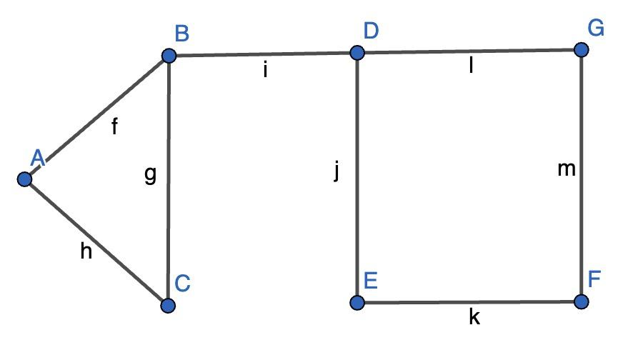
Volume Example
(cluster) | Vol( )
A | 2
A, B | 5
A, B, C | 7
A, B, C, D | 10
… | …

Slide 14
Conductance
Conductance := edge flux / min(vol( ), vol( ))
Edge flux E( , ) := # of edge {u, v} where u in and v in
Edge flux gives us the number of edges between clusters
Measures whether a cut is a “good” cut in the following sense:
Deleting a small number of edges – Minimizing edge flux
“Balanced in size” – maximizing the minimum value of the two volumes
To find the good cluster, we only need to find minimum conductance!!

Slide 15
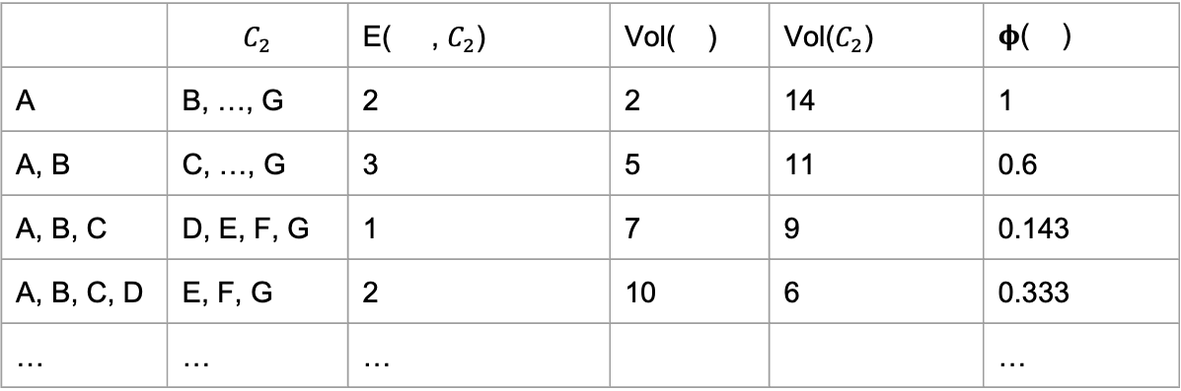
Conductance (cont.)
 | $$C_{2}$$ | E( , $C_{2}$) | Vol( ) | Vol($C_{2}$) | 𝛟( )
A | B, …, G | 2 | 2 | 14 | 1
A, B | C, …, G | 3 | 5 | 11 | 0.6
A, B, C | D, E, F, G | 1 | 7 | 9 | 0.143
A, B, C, D | E, F, G | 2 | 10 | 6 | 0.333
… | … | … |  |  | …

Slide 16
Algorithms to Find “Good” Clusters

Slide 17
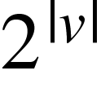
Naive Way: Consider All Possible Clusters
Consider every nonempty subset S of V as potential candidates of our “good” cluster
Calculate the conductance of each candidate
Return the candidate with the smallest conductance
Runtime: O( )
This is VERY slow when |V| is huge

Slide 18

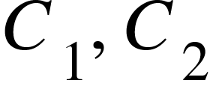
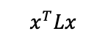
A Better Way: Spectral Clustering
Our good old friend: Laplacian Matrix L
Laplacian matrix gives information about edge flux.
We can express with a vector x whose entries corresponding to vertices in are 1, else 0
gives the edge flux E( , ) = E( )
$$x^{T}Lx$$

Slide 19
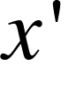
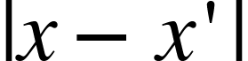
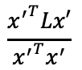
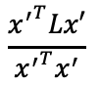
A Better Way: Spectral Clustering (Cont.)
$$\frac{{x^{′}}^{T}Lx′}{{x^{′}}^{T}x^{′}}$$
Want to find a vector such that is minimized
Observation: the smallest non-zero eigenvector achieves
min(. )
Be careful! L has a 0 eigenvector. (we discussed it in class)
Find the corresponding such that is minimized (the algorithm later)
$$\frac{{x^{′}}^{T}Lx′}{{x^{′}}^{T}x^{′}}$$

Slide 20
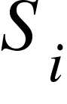
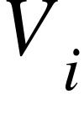
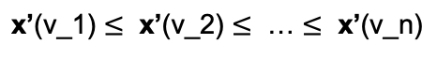
Algorithm (Spectral Clustering)
Find a good approximation of the eigenvector of the smallest non-zero eigenvalue of “normalized L” (can use the power iteration method)
Sort the vertices of V according to :
Iterate over the clusters with each time adding to the cluster. For each iteration calculate the conductance of
Return the cut with minimum conductance
$$\text{x}\text{’}\text{(}\text{v}\text{_1)}≤ \text{x}\text{’}\text{(}\text{v}\text{_2)}≤\text{ …}≤ \text{x}\text{’}\text{(}\text{v}\text{_}\text{n}\text{)}$$

Slide 21
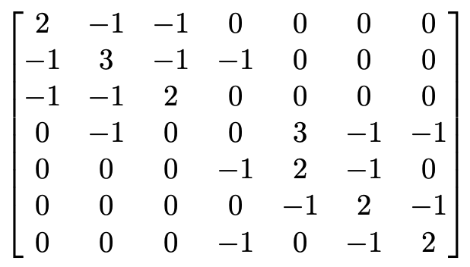
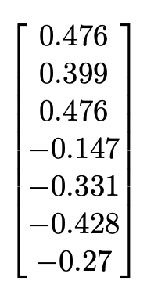
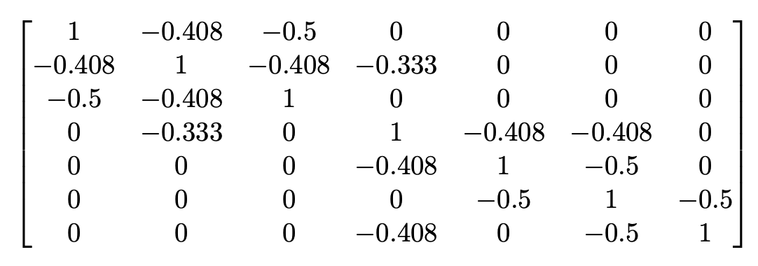
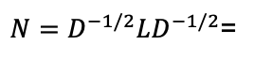
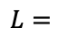
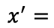
Demonstration (step 1)
$$L=$$
$N=D^{−1/2}LD^{−1/2}$=
$$x^{′}=$$

Slide 22
Demonstration (Step 2 & 3)
Iteration (i) | Vertex | Entry value in |  | 𝛟( )
1 | F | -0.428 | F | 1
2 | E | -0.331 | F, E | 0.5
3 | G | -0.27 | F, E, G | 0.333
4 | D | -0.147 | F, E, G, D | 0.143
5 | B | 0.399 | F, E, G, D, B | 0.5
6 | A | 0.476 | F, E, G, D, B, A | 1
7 | C | 0.476 | F, E, G, D, B, A, C | N/A

Slide 23
Demonstration (Step 2 & 3)
Iteration (i) | Vertex | Entry value in |  | 𝛟( )
1 | F | -0.428 | F | 1
2 | E | -0.331 | F, E | 0.5
3 | G | -0.27 | F, E, G | 0.333
4 | D | -0.147 | F, E, G, D | 0.143
5 | B | 0.399 | F, E, G, D, B | 0.5
6 | A | 0.476 | F, E, G, D, B, A | 1
7 | C | 0.476 | F, E, G, D, B, A, C | N/A

Slide 24
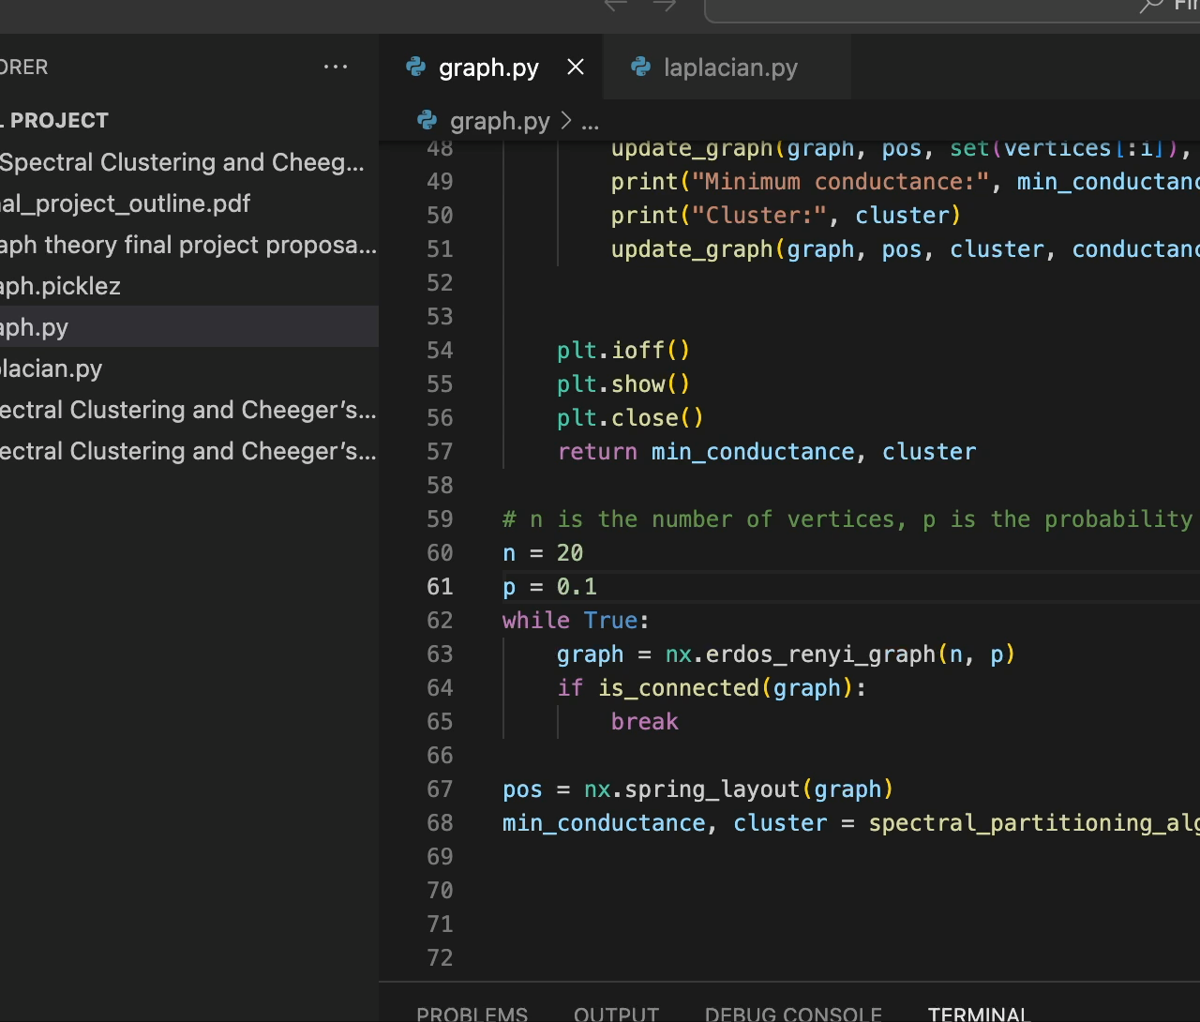
Video Demonstration of the Algorithm
Setup:
Random sparsely connected graph with 20 vertices
Notes:
Run the code

Slide 25
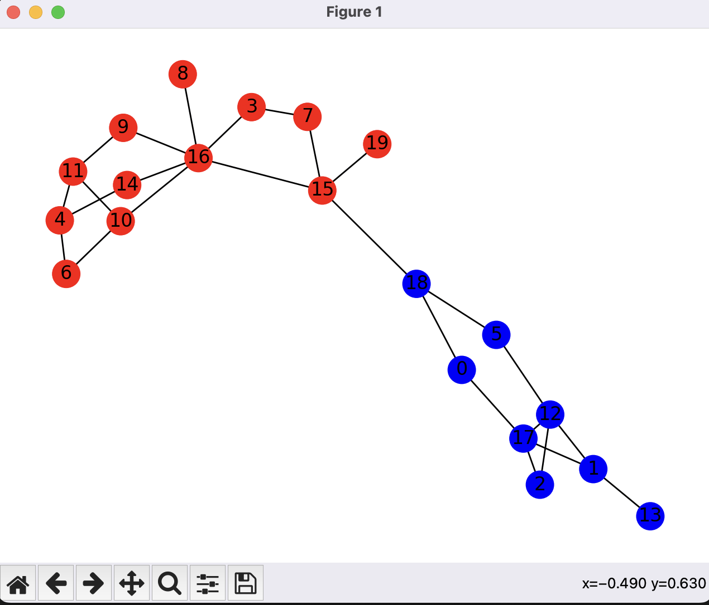
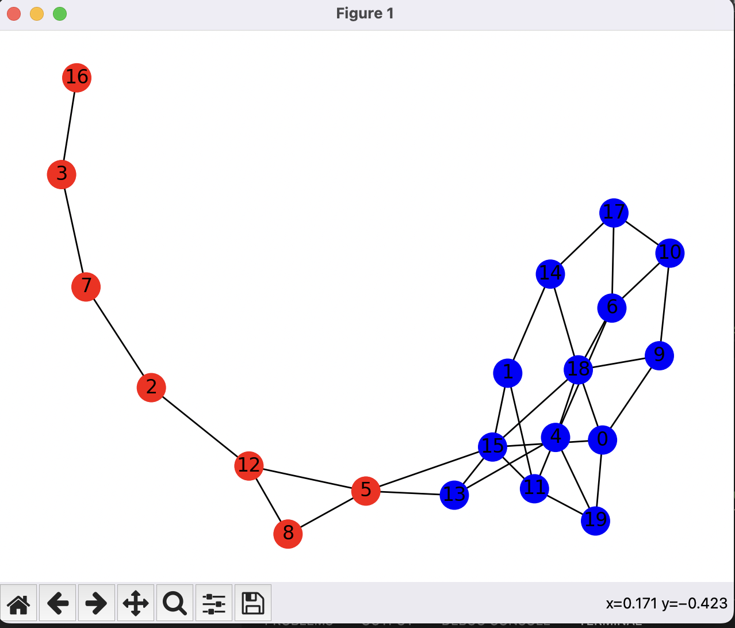
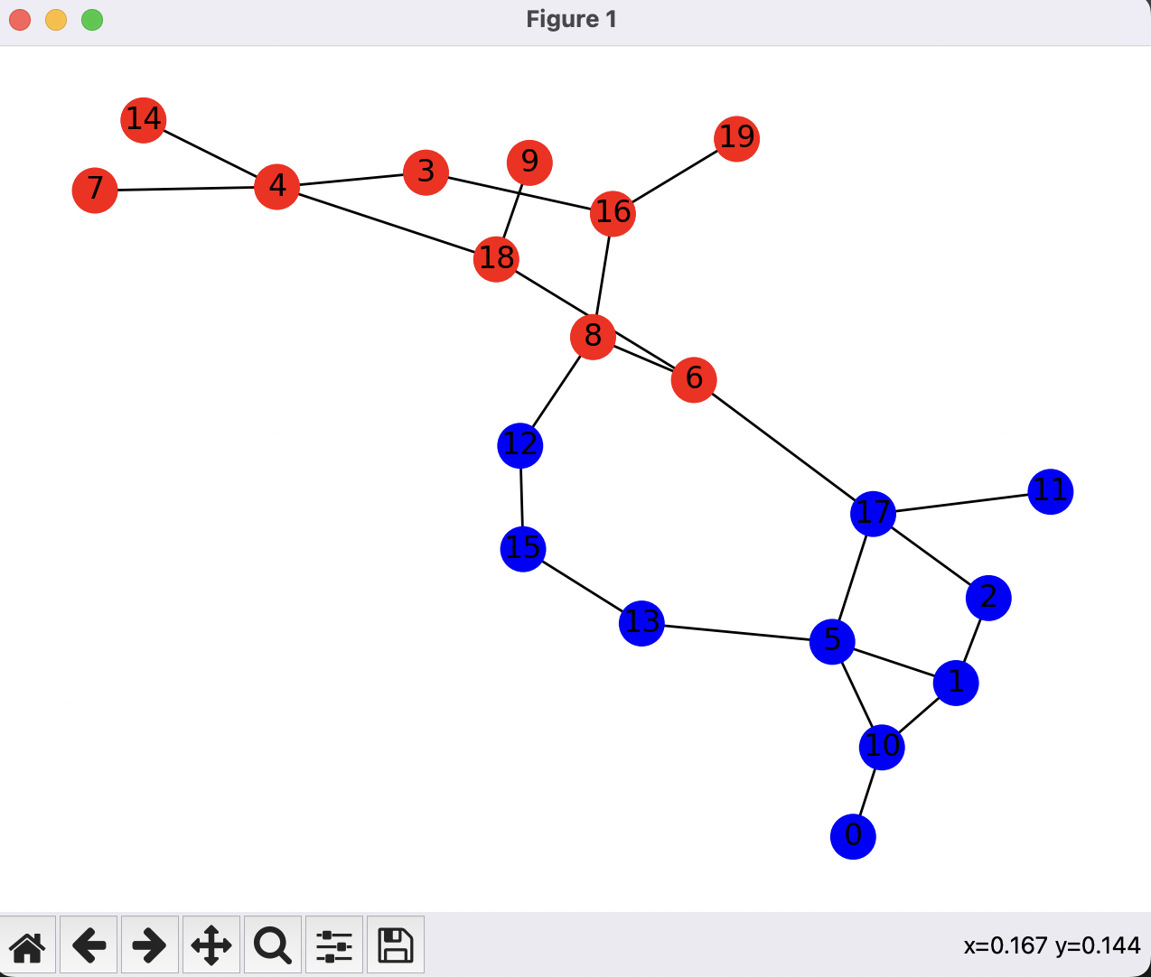
Results

Slide 26
Applications
PageRank: classification of websites in to topics
Community detection: detect communities or groups of nodes with similar connectivity patterns in social networks, biological networks, and other complex networks.
Recommendation Systems: Spectral clustering can be used in recommendation systems to group similar items or users based on their preferences, ratings, or behavior.

Slide 27
References
GPT4 (for the algorithm implementation in python)
Chang, K. C., et al. “THE 1-LAPLACIAN CHEEGER CUT: THEORY AND ALGORITHMS.” Journal of Computational Mathematics, vol. 33, no. 5, 2015, pp. 443–67. JSTOR, http://www.jstor.org/stable/43693873. Accessed 7 Apr. 2023.
Arsić, Branko, et al. “GRAPH SPECTRAL TECHNIQUES IN COMPUTER SCIENCES.” Applicable Analysis and Discrete Mathematics, vol. 6, no. 1, 2012, pp. 1–30. JSTOR, http://www.jstor.org/stable/43666153. Accessed 7 Apr. 2023.
Cvetković, Dragoš, and Slobodan K. Simić. “TOWARDS A SPECTRAL THEORY OF GRAPHS BASED ON THE SIGNLESS LAPLACIAN, III.” Applicable Analysis and Discrete Mathematics, vol. 4, no. 1, 2010, pp. 156–66. JSTOR, http://www.jstor.org/stable/43671298. Accessed 7 Apr. 2023.

